Slide 1

Module 8:
Software Verification, Validation and Testing
PART 1
Software Engineering
School of Computing, Faculty of Engineering
Universiti Teknologi Malaysia

Slide 2
Recap on SDLC Phases & Artefacts
Domain Analysis
@ Business Process
Requirement
Analysis
Design
Implementation
Testing & Deployment
Maintenance & Evolution
Domain Model (Class Diagram)
1) Functional & Non-Functional Requirements
2) Use Case Diagram
1) Sequence Diagram
2) Activity Diagram
3) State Chart Diagram
1) Class Diagram (refined)
2) Sequence Diagram (refined)
1) Application Source Code
2) User Manual Documentation
1) Test Cases
2) Prototype / Release / Versions
1) Change Request Form
SRS
SDD
STD

Slide 3

Outline
Verification and Validation (V&V): Definition, goal, techniques and purposes
Inspection vs. testing: Complement to each other
Software testing:
  Definition, goal, techniques and purposes
  Stages: development, release, user/customer
  Process: test cases, test data, test results, test reports
  Focus in designing test cases to perform testing based on three strategies:
  (i) Requirement-based (ii) Black-box (iii) White-box

Slide 4

Objectives
To discuss V&V differences and techniques
To describe different types of testing and its definition
To learn three strategies for generating system test cases

Slide 5
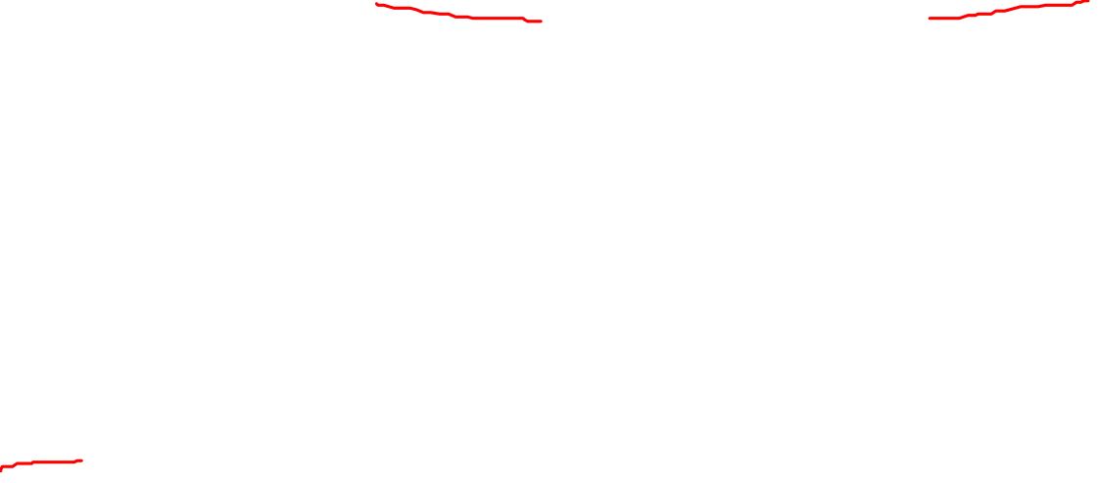
Verification vs. Validation
(Boehm, 1979)
Verification:
“Are we building the product right”
  The software should conform to its specification
Validation:
“Are we building the right product”
  The software should do what the user really requires

Slide 6
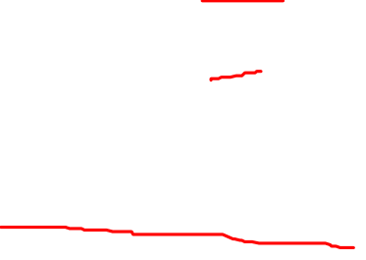
V&V Goal
V&V should establish confidence that the software is fit for purpose
This does NOT mean completely free of defects
It must be good enough for its intended use and the type of use will determine the degree of confidence that is needed

Slide 7

V&V: Degree-of-Confidence Category
Software function/purpose
  The level of confidence depends on how critical the software is to an organisation e.g. safety-critical system
User expectations
  Users may have low expectations of certain kinds of software (user previous experience, unreliable software especially newly installed software)
Marketing environment
  Getting a product to market early may be more important than finding defects in the program (competitive environment – release program first without fully tested to get the contract from customer)

Slide 8
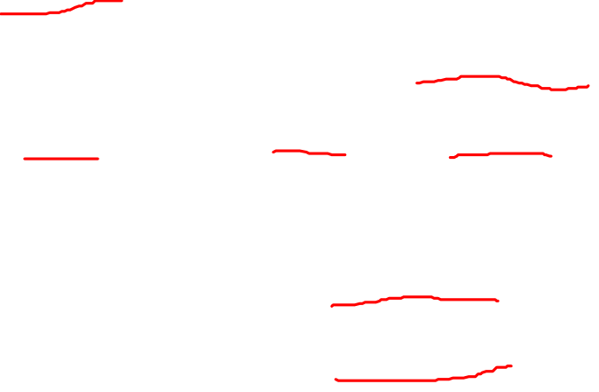
V&V: The Techniques
Verification Technique:
  Prototyping
  Model Analysis e.g. Model checking, can be validation
  Inspection and review (Static testing)
Validation Technique:
  Software Testing (Dynamic testing)
  Code Inspection (Static analysis)
Independent V&V

Slide 9
Technique: Prototyping (Verification)
“A software prototype is a partial implementation constructed primarily to enable customers, users, or developers to learn more about a problem or its solution.” [Davis, 1990]
“Prototyping is the process of building a working model of the system.” [Agresti,1986]

Slide 10
Technique: Model Analysis (V&V)
Verification:
  Is the model well formed?
  Are the parts of the model consistent with one another?
Validation:
  Animation of the model on small examples
  Formal challenges: “if the model is correct, then the following property should hold...”
  ‘What if’questions:
    reasoning about the consequences of particular requirements
    reasoning about the effect of possible changes
    “will the system ever do the following...”

Slide 11
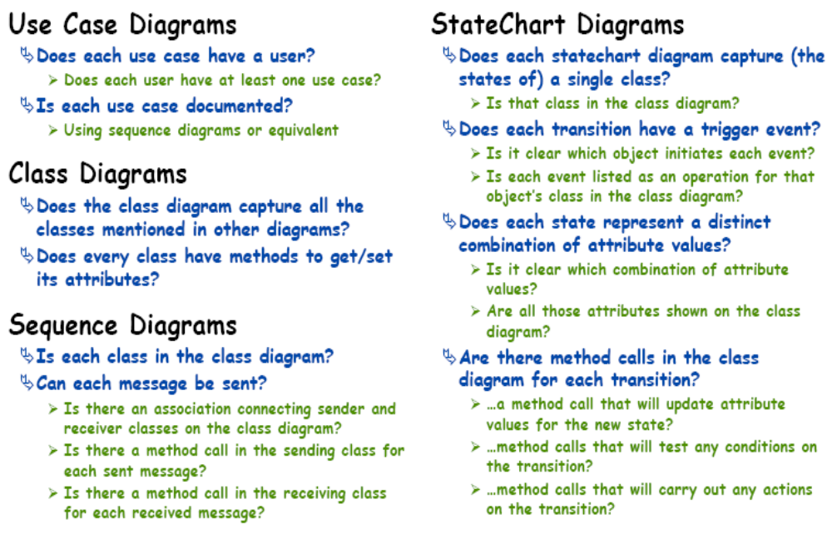
Technique: Model Analysis Example
Basic Cross-Check for UML (Verification)

Slide 12
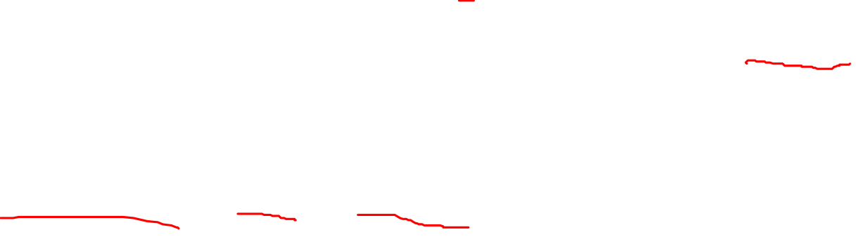
Technique: Software Inspection (Verification)
The technique involves people examining the source representation with the aim of discovering anomalies (deviation from standard/expectation) and defects (errors)
It does not require execution of a system – static test, so it may be used before implementation
They may be applied to any representation of the system (e.g. requirements, design, test data)
It is an effective technique for discovering program errors

Slide 13
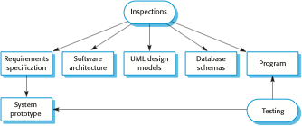
Verification - Inspection (Static) and
Validation - Testing (Dynamic)

Slide 14
Inspection (Static)
Inspection (static)

Slide 15
Testing (Dynamic)
Testing (dynamic)

Slide 16
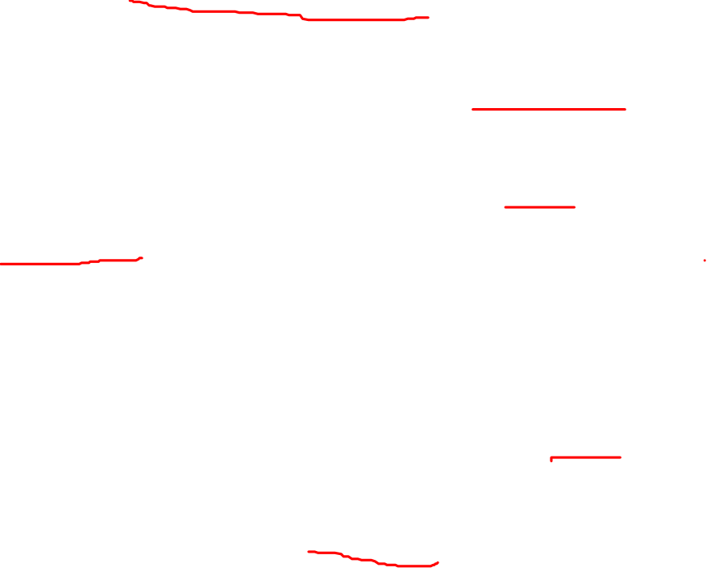
Advantages of Inspections
During testing, errors can mask (hide) other errors. As inspection is a static process, it need not to be concerned with interactions between errors.
Incomplete versions of a system can be inspected without additional costs. Compared to dynamic testing, if a program is incomplete, need to develop specialized test that is connected in order to test the parts that are available.
Besides searching for program defects, an inspection can also consider broader quality attributes of a program, such as compliance with standards, portability and maintainability (inefficiencies, inappropriate algorithms, poor programming style which make a system to be difficult to maintain & update).

Slide 17
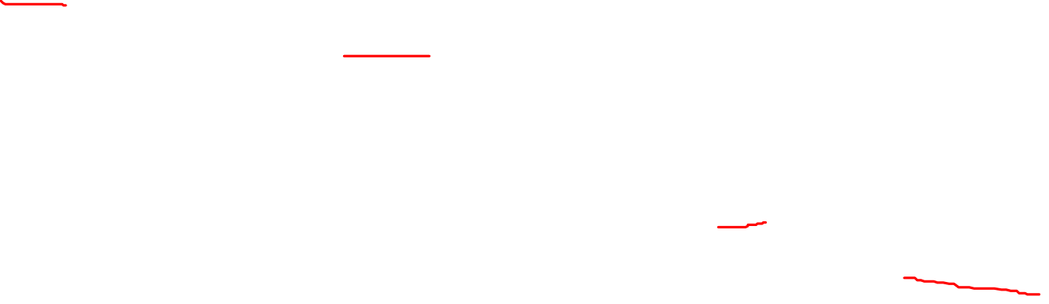
Inspections vs. Dynamic Testing?
Software inspection and review concerned with checking and analysis of the static system representation to discover problems (“static test”: no execution needed)
  May be supported by tool-based document and code analysis (“static analysis”)
Software testing concerned with exercising and
observing product behaviour (“dynamic test”: needs execution)
  The system is executed with test data and its operational behaviour is observed
  “Testing can only show the presence of errors, not their absence” (Dijkstra et al. 1972)

Slide 18
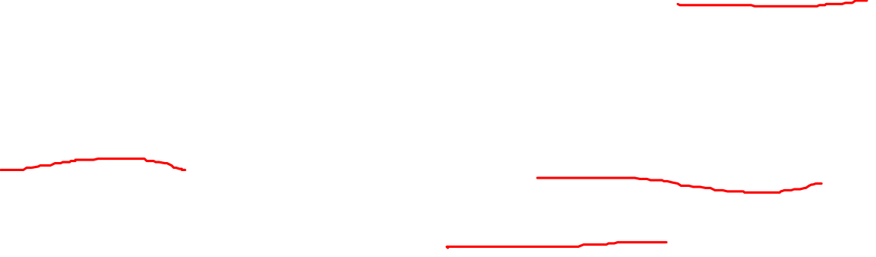
Inspections vs. Dynamic Testing?
Inspections and dynamic testing are V&V verification techniques
Both should be used during the V&V process
Inspections can check conformance with a specification (system) but not conformance with the customer’s real requirements
Inspections cannot check non-functional characteristics such as performance, usability, etc.

